Slide 1
L01 - Eclipse and Functional Programming Introduction
Dr John H Robb, PMP
UT Arlington
Computer Science and Engineering

Slide 2
Introduction to Eclipse

Slide 3
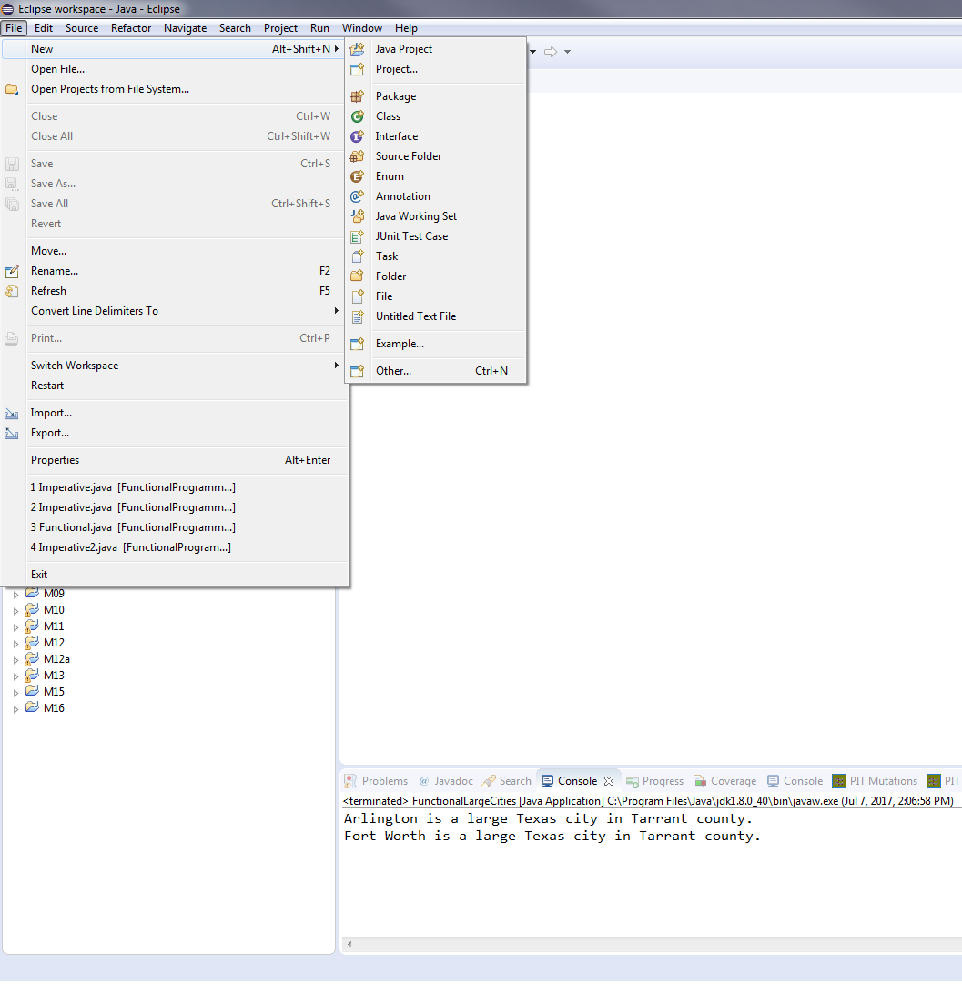
Eclipse
Create a new Java Project
Select File -> New -> Java Project

Slide 4
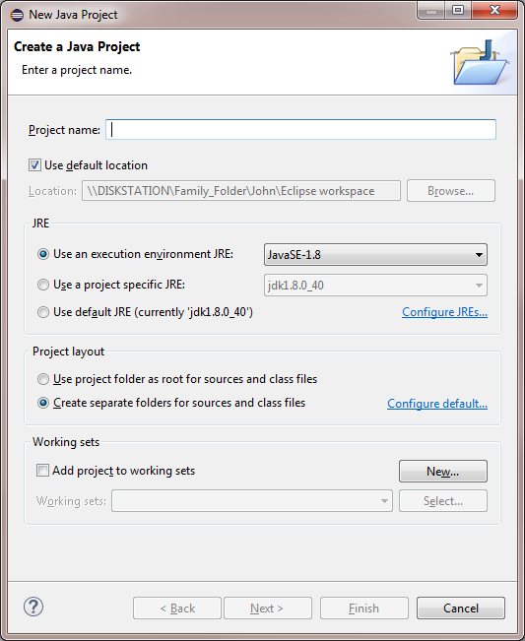
Eclipse (cont)
Fill in the template
Click Finish

Slide 5
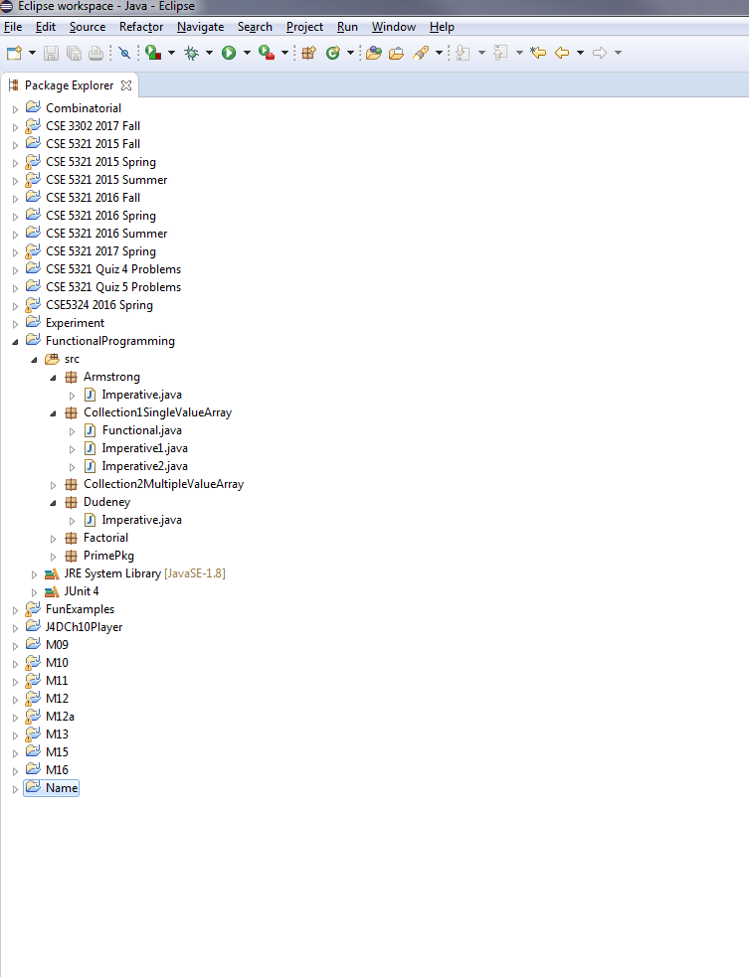
Eclipse (cont)
2
Make sure Project name is selected
Click on New Java Package

Slide 6
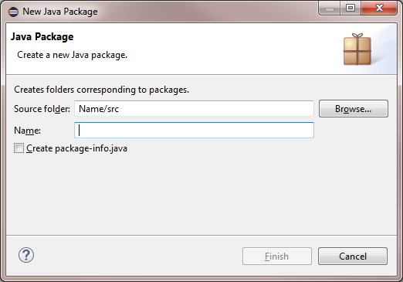
Eclipse (cont)
Give the Package a name
Click on Finish

Slide 7
Eclipse (cont)
2
Select Package you just created
Click on New Java Class

Slide 8
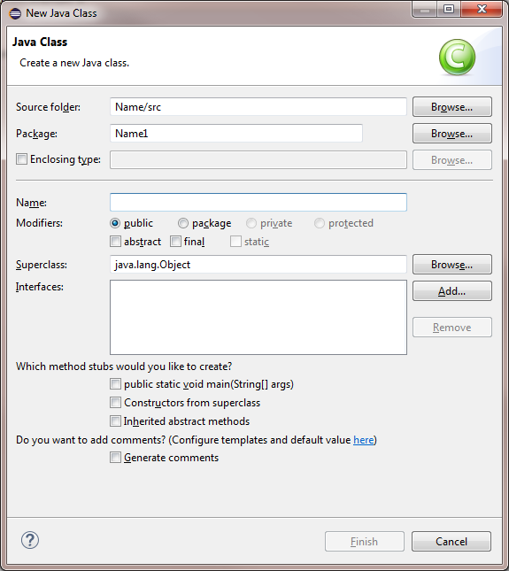
Eclipse (cont)
1
Fill in Class name
Click Finish
This creates a NEW Java class - to import a Java Class do the next slide

Slide 9
Eclipse (cont)
1
File -> Import... - General - Archive File

Slide 10
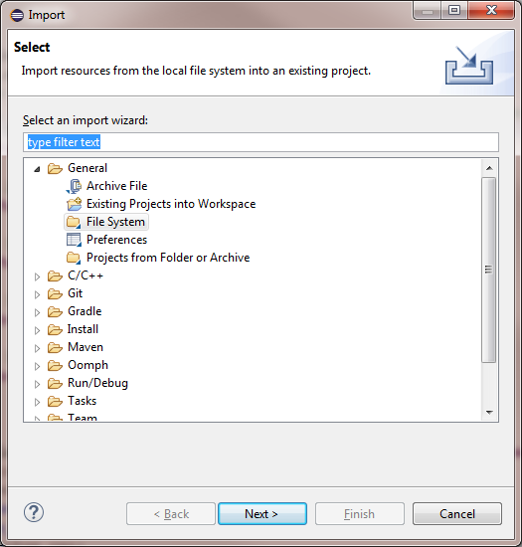
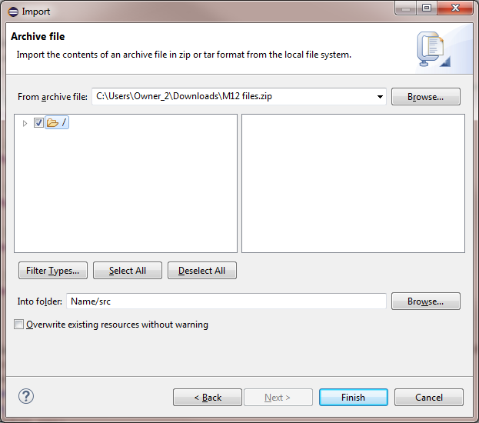
Eclipse (cont)
Import ... - General - Archive File
Select the files downloaded from Blackboard
Click on the folder name and click Finish
3.
5.

Slide 11
Eclipse Demonstration of L01

Slide 12
Imperative Programming - What Is It?
Imperative programming is performed by telling the compiler each step to take in the program - we tell the compiler HOW to do the program
Example: a method to determine if a number is a prime number
Definition: A Prime number is an integer > 1 that has no positive divisors other than 1 and itself
Student question: what is wrong with Imperative programming?

Slide 13
Imperative Program Example
With Imperative programming much of the complexity in the code deals with HOW to instruct the compiler on a step by step basis
A lot of complexity is tied to HOW to tell the compiler step-by-step to determine if a number is prime
terminate loop if it has divisors
test each integer up to number-1
hasDivisors=true if number is a multiple of i
the number is Prime if it has no divisors and it is greater than 1

Slide 14
Imperative Program Example (cont.)
Complexity increases because we tell the compiler what to do step-by-step - increases in complexity cause a lot of issues
These lines of code will tend to be more error prone - we get a step out of sequence or the logic wrong
They are harder to pick up and understand especially if not well commented
Imperative programming is an important first step in programming - it helps us become more logical thinkers, but we need to
Develop more error proof code
We need to develop more understandable code
This is where Functional programming is important - it focuses on what the code must do and much less on how

Slide 15
Functional Programming Example
The same isPrime method now using a Java 8 Lambda Expression
There is no for loop, no boolean loop termination condition, no loop incrementer - the code describes WHAT the expression does
There is no mutable variable
Parallel execution - the code generated by the compiler would allow each determination to be executed in parallel (if the target processor supports it)
What is a mutable variable?

Slide 16
Functional Programming Benefits
Avoids variable mutations
We avoided explicit mutation or reassignment of variables, which are often sources of bugs
In the imperative version we repeatedly set the total variable within the loop.
Avoids sequential assignments
In the functional version the code can evaluate each member in the stream in different orders or completely in parallel
In the imperative version we reassigned the total variable which made it hard to make the code concurrent.
The code focuses on what the function does, not on how
In the imperative version we convey the intent in multiple steps create an initial dummy value, loop, add discounted values to the variable
In the functional version we simply ask the list’s map() method to return another list with discounted values and sum it.

Slide 17
Background
Functional programming begins in Java 8 with Lambda Expressions
It also uses other constructs in Java (Functional Interfaces)
Streams are used to work with collection
For Lab 1 we will review

Slide 18
What is a Lambda Expression?
A lambda expression consists of a set of parameters, a lambda operator (->) and a function body.
The following are examples of Java lambda expressions:

Slide 19
What is a Lambda Expression? (cont.)
Lambda Expression Parameters
A lambda expression can have zero, one or more parameters
The type of the parameters can be explicitly declared or inferred from the context
Parameters are enclosed in parentheses and separated by commas
Empty parentheses are used to represent an empty set of parameters
When there is a single parameter, if its type is inferred, it is not mandatory to use parentheses
Lambda Expression Body
The body can contain zero, one or more statements
For single statements curly brackets are not mandatory - they are for more than one statement
The return type of the anonymous function is the same as that of the body expression (may be void if nothing is returned)

Slide 20
Important Functional Interfaces in Java 8
Interface Name | Arguments | Returns | Example
Predicate<T> | T | boolean | Is something true (or false)
Consumer<T> | T | void | Printing a value (or a setter - performing an action)
Function<T,R> | T | Returns | Get the name of a city
Supplier<T> | None | T | A factory method (or a getter)
UnaryOperator<T> | T | T | Square a number
BinaryOperator | (T , T) | T | Summing two numbers

Slide 21
Using Lambda Expressions
Lambda Expressions are not usable by themselves - they have to be bound to a specific object (target type)
These all require a functional Interface to define types
Streams are another way that we can use Lambda Expressions - to be discuss later (M02)

Slide 22
Using Lambda Expressions (cont.)
Executable (using) code for the previous slide follows (see Check1.java):
Study how parameters are passed - each is different
Use eclipse with the function name and the "." after the function name to show what function can be used - see demo

Slide 23
Using Lambda Expressions (cont.)
The following example shows the use of one of the Lambda Expressions
.test(n) is used to assign the input to the Predicate isOdd
A predicate returns a boolean value

Slide 24
Using Lambda Expressions (cont.)
An additional way to define Lambda Expressions in Java
The signature in the Interface class tells the compiler the method returns an int value and accepts an int as a parameter
1)
2)
1) The function is declared using the defined interface above
2) Notice that the squareFunction.method uses the name of the method defined in the interface

